Slide 1
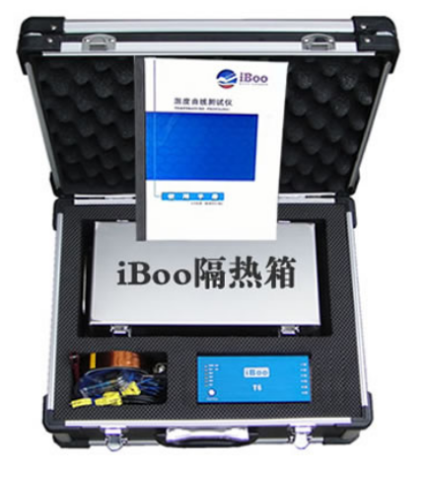
Reflow Oven Profiler with 6 Channels---iBoo-T6
Instruction:
The superior thermal insulation performance of iBoo reflow overn profiler enables the test system to conduct temperature mapping in harsh thermal environment. Through the reflow oven together with the product, the temperature of the reflow oven and products can be tracked and monitored in the whole process. Valuable data can be obtained without drag couple test. The curve analysis report can immediately provide engineers with the real temperature status of the product and oven, and will tell you how to optimize the operation. By balancing temperature, time and heating rate, you can improve line speed and product quality and achieve efficient production.
iBoo reflow oven profiler also suitable for using in wave sodlering machine, it’s in a leading position in profiler technology.

Slide 2
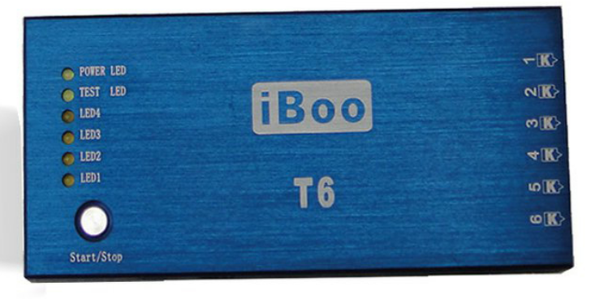
Reflow Oven Profiler with 6 Channels---iBoo-T6
Tech Spec
Built in lithium battery，chargeable，the battery capacity and the remaining test time can be showed on software.
Built in 8M high-quality memory chip and unique power-off protection function. Once power-off, the built-in program will save data immediately.
Max storage record: 4 times testing record
Power consumption≤35mA
Model | T6 | Battery | Li-ion 850mA
Channel | 6 | Overall Size | 20*62*138mm
Acquisition rate | 0.05S-16M | Heat insulation box | 198*104*32mm
Accuracy | ±1℃ | Voltage | DC3.7-4.2V
Resolution | 0.1℃ | Memory | 8M
Max inner temp | 85℃ | Measuring range | 0℃-1370℃
Star Mode | Button/time-delay/temperature | Thermocouple | K-type

Slide 3
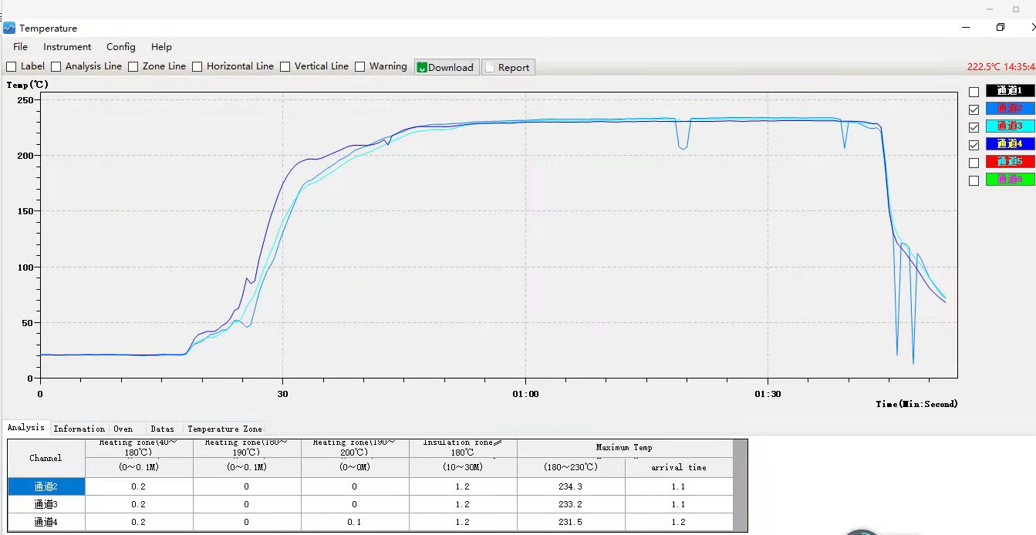
Software
Curve analysis
HomePage

Slide 4
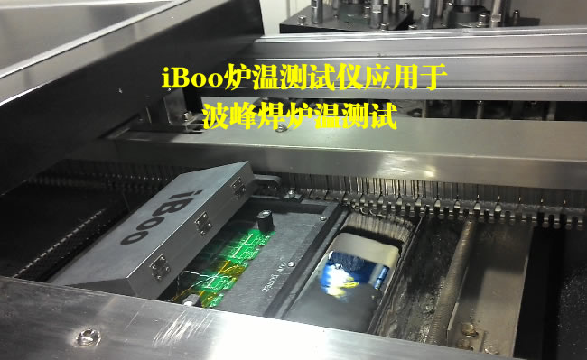
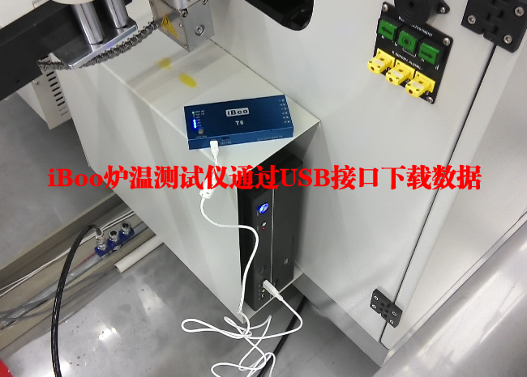
Application
iBoo be used in wave sodering machine
Download data to PC by USB

Slide 5
Best After-sales service
— 7x24 Worldwide Support
— Free Installation/ Training
— 1 day lead-time (spare parts)
— 1 Month customize solution

Slide 6
WELCOME INQUIRY
Please visit
www.smthelp.com
Find us more
https://www.facebook.com/autoinsertion
Know more our team
https://cn.linkedin.com/in/smtsupplier
Welcome to our factory in Shenzhen China
See more machine working video, please Youtube
Auto Insertion
Google
Auto+insertion, to get more information
Looking forward to your email
tracy@smthelp.com

